Slide 1
Predicting NFL Matchup Winners
Jonathan Koski - Springboard Capstone 2

Slide 2
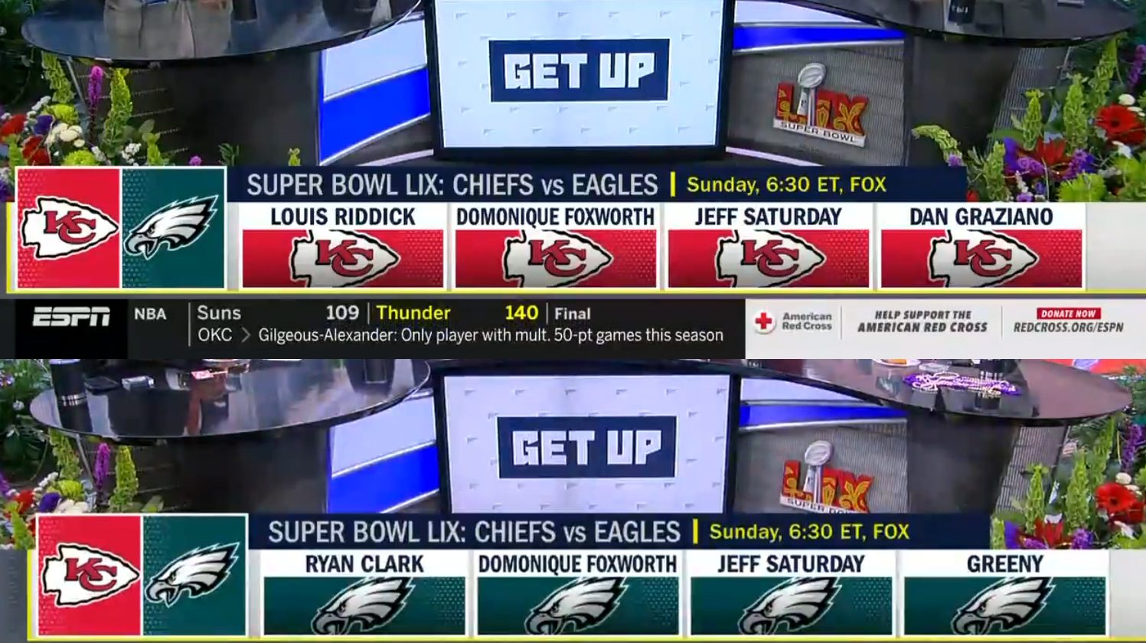
The Problem
NFL games are influenced by complex, often unpredictable factors. This project aims to reduce that noise by using large-scale historical data to uncover patterns that help predict game winners more accurately.

Slide 3


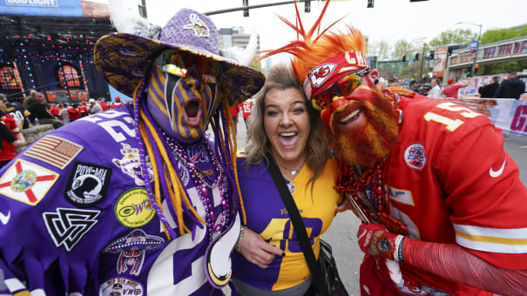



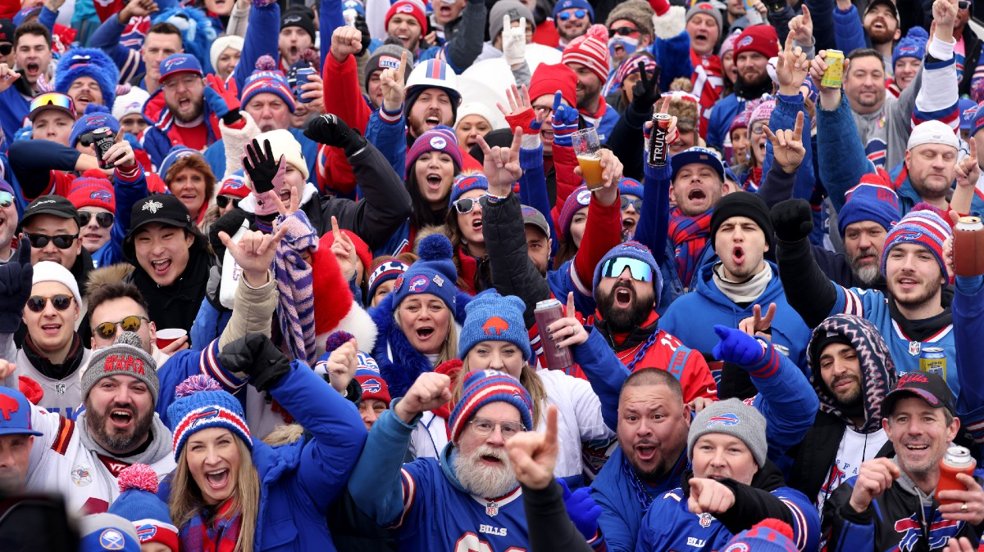

Who might care?
Teams, NFL Sportsbooks, Bettors Fans

Slide 4

The Data
Game level data on all matchups for the 2017-2024 seasons
2200+ games
Dates, Teams, Points, Yards, Turnovers
Scraped into CSV format
Merged season data into one DF
All data used comes from pro-football-reference.com

Slide 5
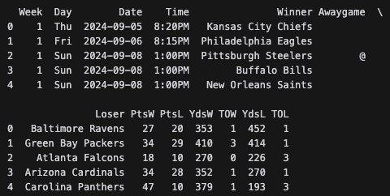
Data Wrangling and Cleaning
Goals:
Remap historical team names
Create a Home Team win column
Remove Awaygame column
Convert winner/loser stats to home/away stats
Early feature engineering (rolling averages, differentials)
Remove outliers, tie games
Subset half of 2024 season for predictions

Slide 6
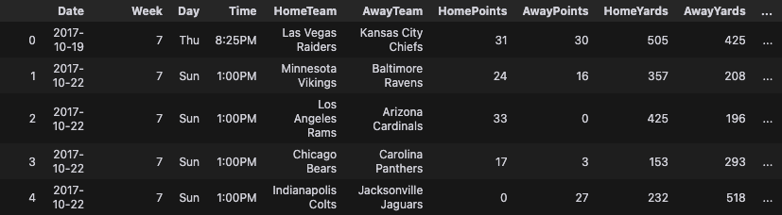
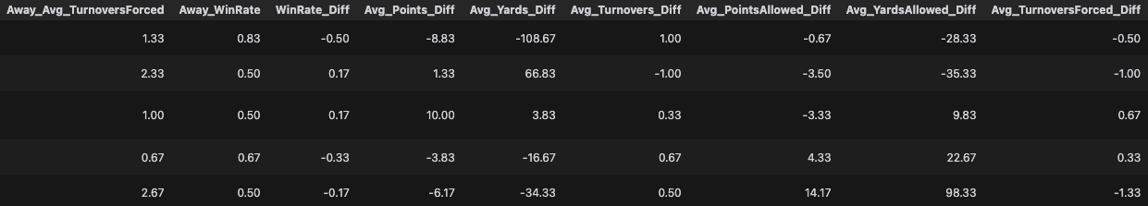
Cleaned Data Frame with features
2034 rows, 36 columns

Slide 7
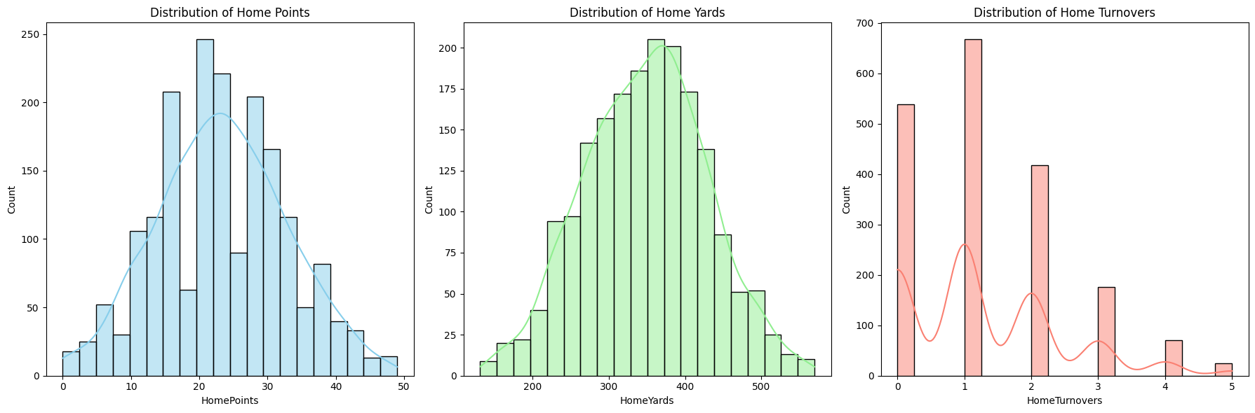
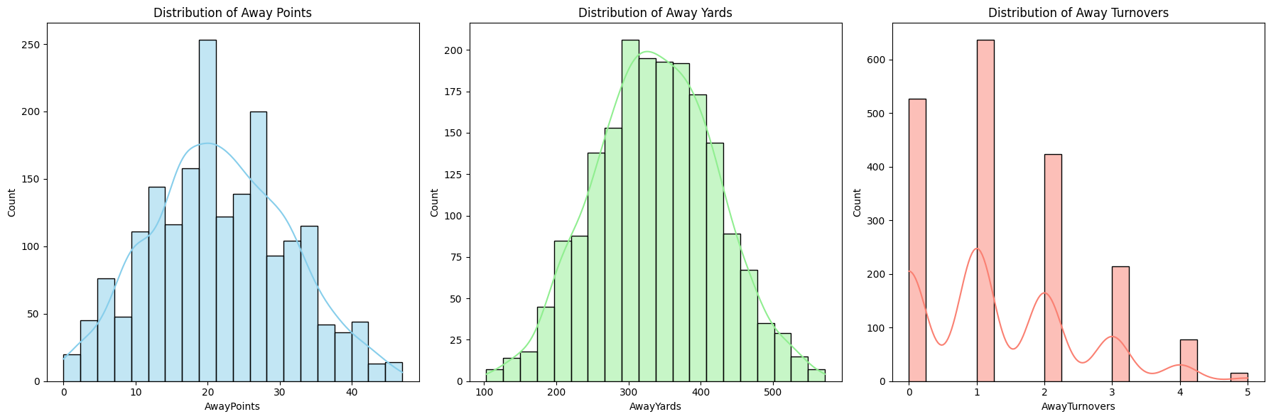
Data Exploration
Home
Away

Slide 8
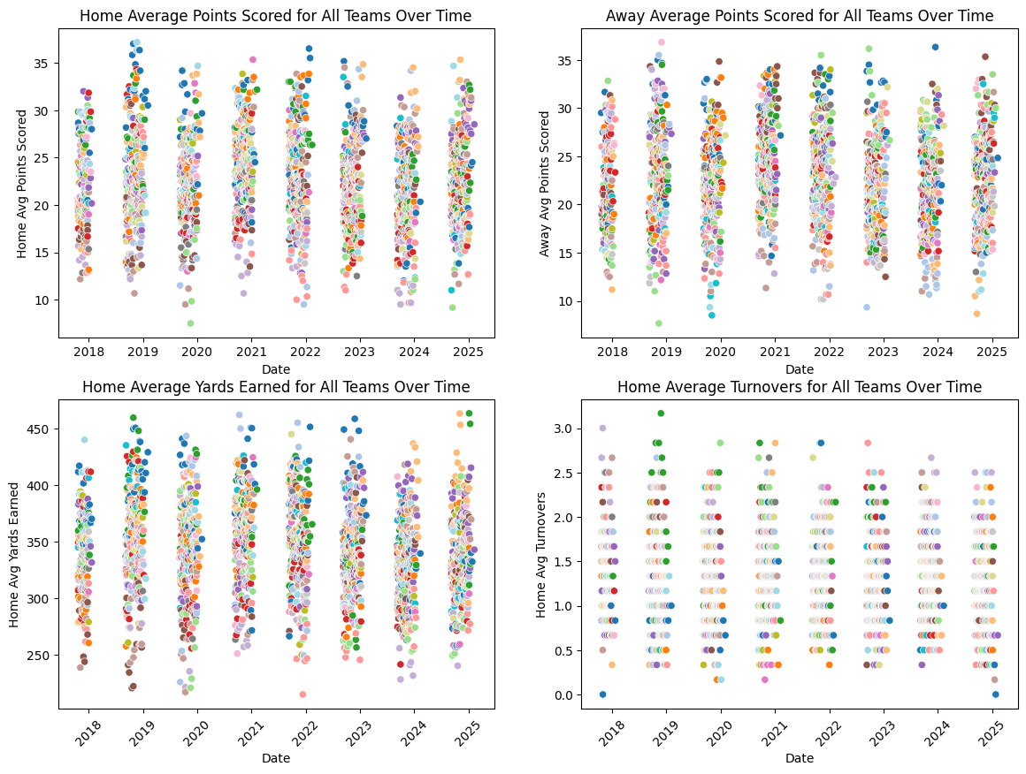
Rolling Averages Visualized

Slide 9
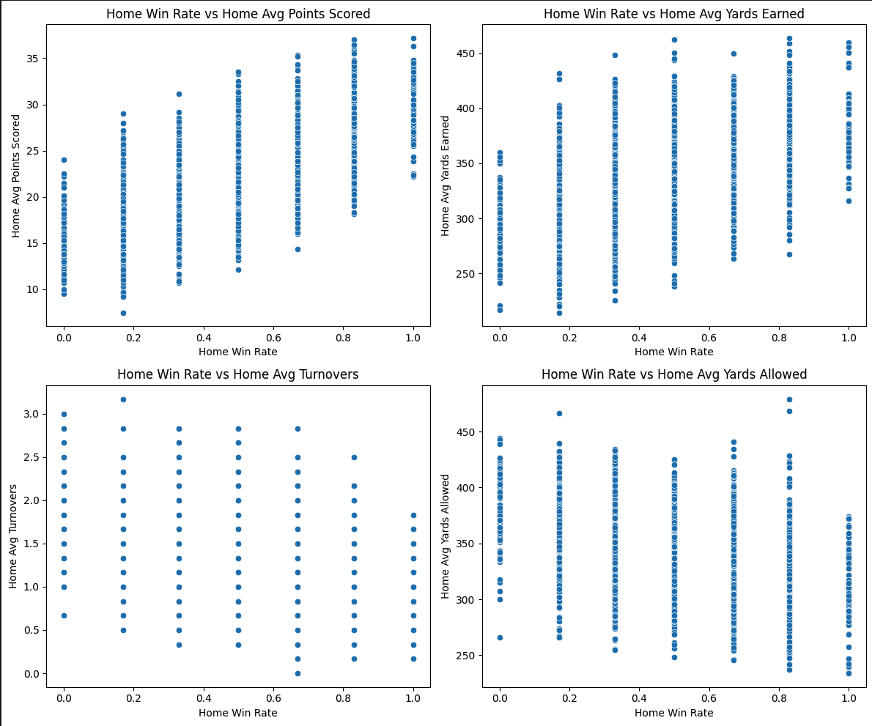
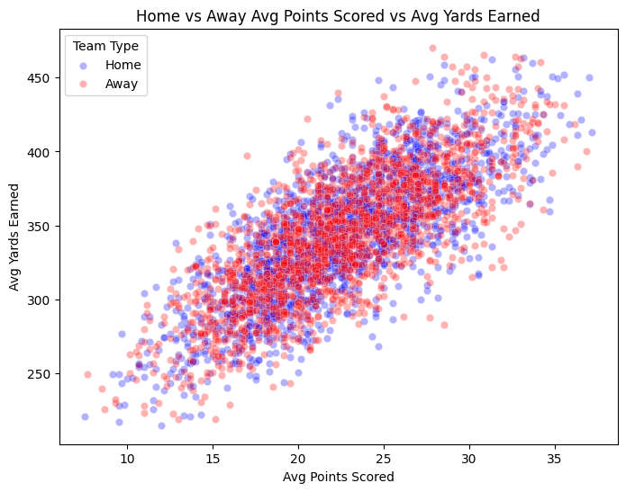
Relative Trends
More Points = More Wins
More Yards = More Points
Less Turnovers = More Yards

Slide 10
Modeling
Goals: Classify a Home Win
Tools - Scikit Learn
Preprocessing: Train Test Split, StandardScaler
Models: Logistic Regression, Random Forest Classifier
Tuning: GridsearchCV
Metrics: Classification Report, Confusion Matrix, Roc Curve

Slide 11
Preprocessing
Split data into 80% - 20% test train split:
Training on 1514 games
Testing on 379 games
Scale data
Class weight:
Home win ~55%
Away win ~45%
Full Data Frame
Training
Test

Slide 12
Initial Models
Logistic Regression | Predicted Home Loss | Predicted Home Win
True Home Loss | 73 | 91
True Home Win | 56 | 159
Both models showed moderate predictive power
Accuracies just above 60%
Both better at predicting wins than losses
Random Forest Classifier | Predicted Home Loss | Predicted Home Win
True Home Loss | 83 | 81
True Home Win | 67 | 148
Notes:
Both models start around 61% accuracy and lean toward predicting wins more reliably than losses. Logistic Regression gives us a clean baseline with solid recall for winners, while Random Forest already shows some benefit from capturing non-linear patterns. These results helped guide my tuning strategy and feature evaluation

Slide 13
Tuning
GridsearchCV - 5 folds
Log Reg: C=0.01, solver = liblinear
Score: 0.6175
RF Classifier: n_estimaters = 100, max depth = 5, max features = sqrt, min samples split = 2, min samples leaf = 2
Score: 0.6228
Notes:
Marginal difference in score, however given RF being less prone to overfitting and having the higher CV score, I chose to use this model

Slide 14
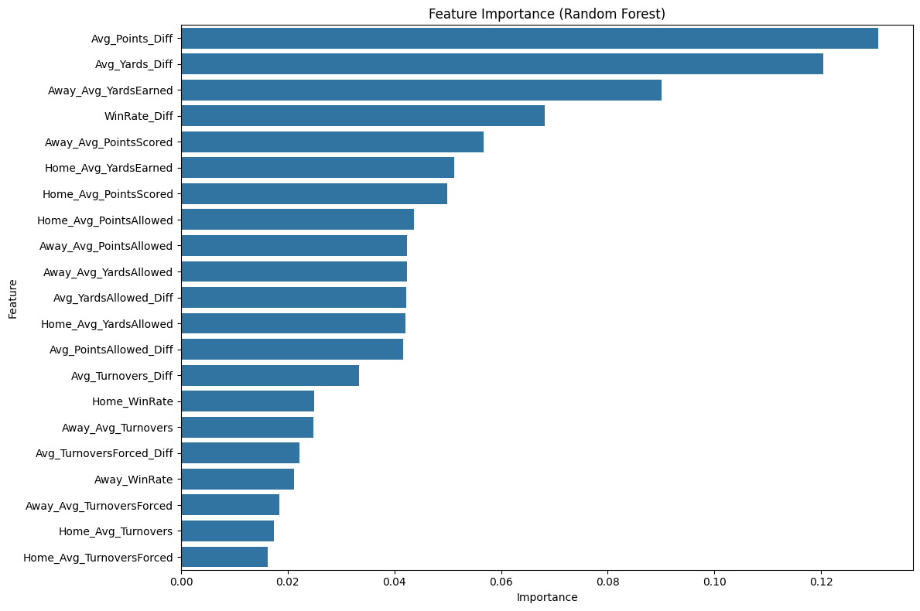
Feature importance
Top 4 Features
Avg Point Diff
Avg Yard Diff
Away Avg Yards Earned
Win Rate Diff
~40% of decision weight

Slide 15
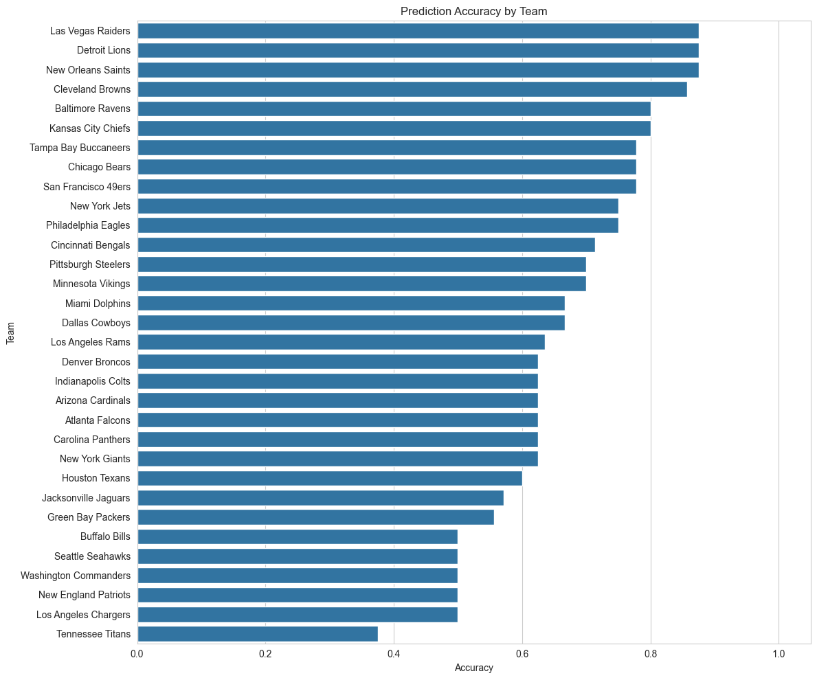
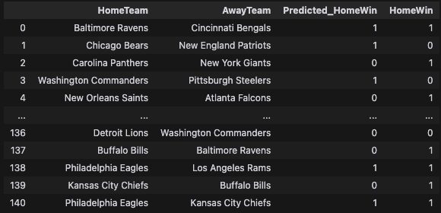
Random Forest Predictions
Refit on new subset of data
Predicted 67% of home wins correctly

Slide 16
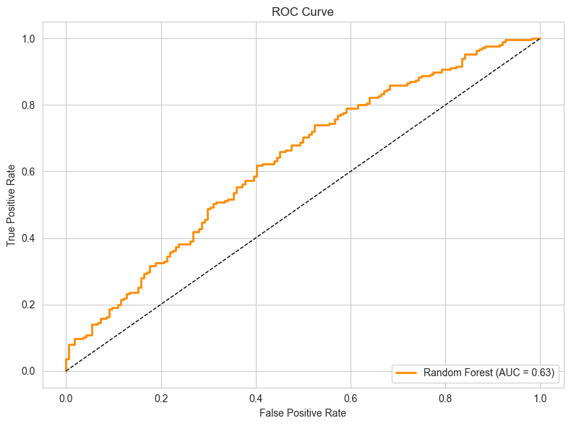
ROC curve
AUC 0.63 seems relatively low
Model shows moderate predictive capabilities
Context of the problem, 63% is a not bad for historical data
Outperforms random guessing, or picking the home team to win every game

Slide 17
Next Steps
More Tuning
Ensemble Models
Granular Data
Player level
Weather
Performance vs Specific teams
Time of day

